Slide 1
VIP Complaint Tool
Ericsson Tools Team | SL MS

Slide 2
Content
Introduction
Features
Usage
Samples

Slide 3
Introduction
SMS interface to receive complains about VIP users, the application is integrated with multiple data sources.
Ericsson OSS-RC
HP Service Manager
Anritsu
Notification layer with SMS and Emails.
Graphs generation for KPIs.
Concurrency to decrease the processing time of request

Slide 4
Features
Multi-vendor Trace
Graphs
Email Notifications
SMS Notifications
Concurrency for parallel requests handling
Requests logging

Slide 5
Usage
Authorized user send a request using the below format
V2011XXXXXXXX
User get an SMS to acknowledge his request and to inform him with the email destination.
After processing the request the user will receive a confirmation SMS and notification that the email is sent.
The email will have the below information:
VIP Customer’s route for the past 2 hours
Tickets on the sites in the route
Alarms on the sites in the route
KPIs for the cells covering the customer

Slide 6
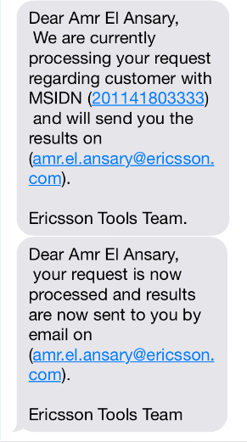
Samples
SMS Sample:

Slide 7
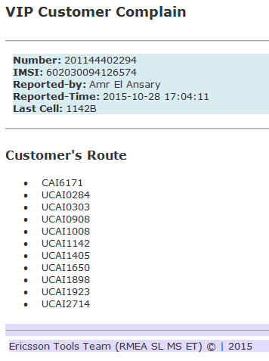
Samples
Email Sample:

Slide 8
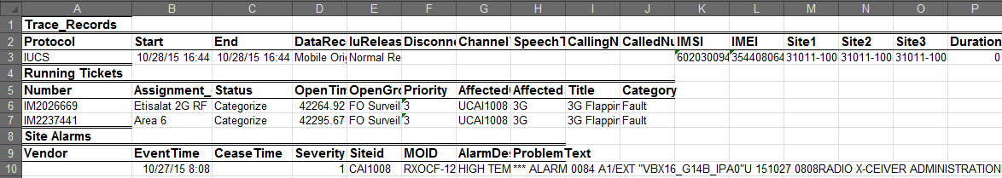
Samples
Trace Sample:

Slide 9
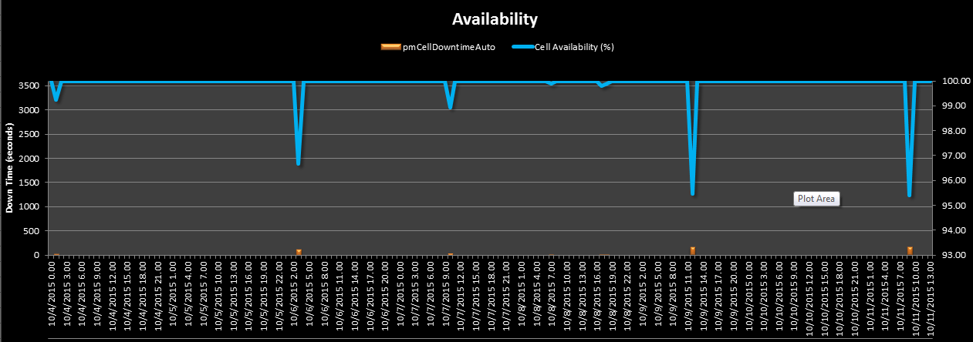
Samples
KPIs Sample:

